Slide 1
Concurrency
By
Maj Dr Asif Masood

Slide 2
Concepts of Concurrency comes in
Multiprogramming ?
Parallel Processing ?
Common problems
Sharing of global resources like global variable and I/O devices etc

Slide 3
Concurrency Problem Example
void echo()
{
chin = getchar();
chout = chin;
putchar(chout);
}

Slide 4
Concurrency Problem Example
Process P1 Process P2
. .
chin = getchar(); .
. chin = getchar();
chout = chin; chout = chin;
putchar(chout); .
. putchar(chout);
. .

Slide 5
Race Condition
Two or more processes are running in parallel
There is no control over their speed
Example 1
P1 make a=1, P2 make a=2
Final value of a will depend upon which process run at the end
Example 2
b=1, c=2
P1: b=b+c, P2: c=b+c
P1 runs first, result b=3, c=5
P2 runs first, result b=4, c=3

Slide 6
OS Concerns
Only one process (at any instant) should be in the critical section (known as Mutual Exclusion). Need to introduce some type of locks on the resource.
Some time sequence of process execution is important. OS should facilitate that also.
Output should be independent of the speed of processes.

Slide 7
Problems associated with Mutual Exclusion
Deadlocks
Starvation

Slide 8
Requirements of Mutual Exclusion
Only one process at a time is allowed in the critical section for a resource
No deadlock or starvation
A process must not be delayed access to a critical section when there is no other process using it
A process remains inside its critical section for a finite time only

Slide 9
Implementation of Mutual Exclusion
Interrupt Disabling
while (true)
{
/* disable interrupts */;
/* critical section */;
/* enable interrupts */;
/* remainder */;
}
Mutual Exclusion is guaranteed
Process must interrupt before it is given excess
Multiprogramming is not possible
Not workable in multiprocessor architecture

Slide 10
Special Machine Instructions
Test and Set Instruction
boolean testset (int i) {
if (i == 0) {
i = 1;
return true;
}
else {
return false;
}
}

Slide 11
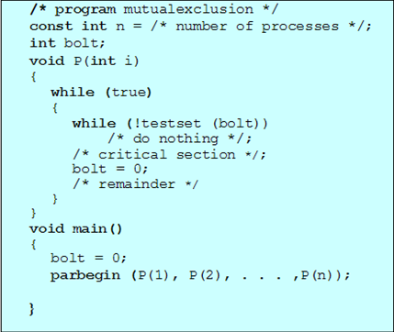

Slide 12
Special Machine Instructions
Exchange Instruction
void exchange(int register, int memory) {
int temp;
temp = memory;
memory = register;
register = temp;
}

Slide 13
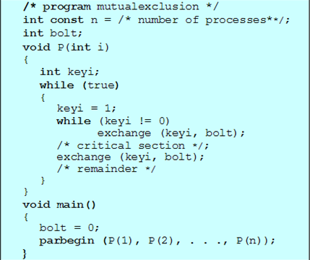
Bolt=0 means no process in critical section
Bolt=1 means only one process in critical section having key=0.

Slide 14
Problems in implementation using Special Machine Instruction
Busy waiting is employed
Starvation is possible
Deadlock is possible
Example: P1 is interrupted in critical section by a higher priority interrupt P2

Slide 15
Semaphores
Any system of sending signals like light or flags
In operating system
Signal to wait (lock); semWait
Signal to proceed (unlock); semSignal

Slide 16
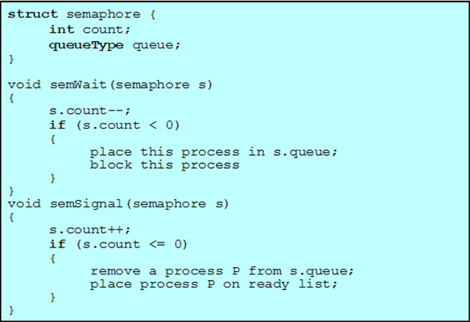

Slide 17
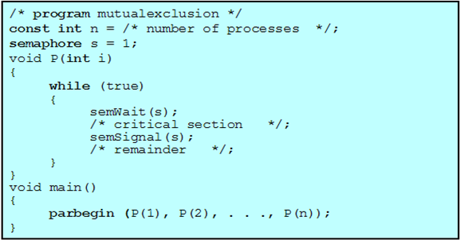
Mutual Exclusion using Semaphores

Slide 18
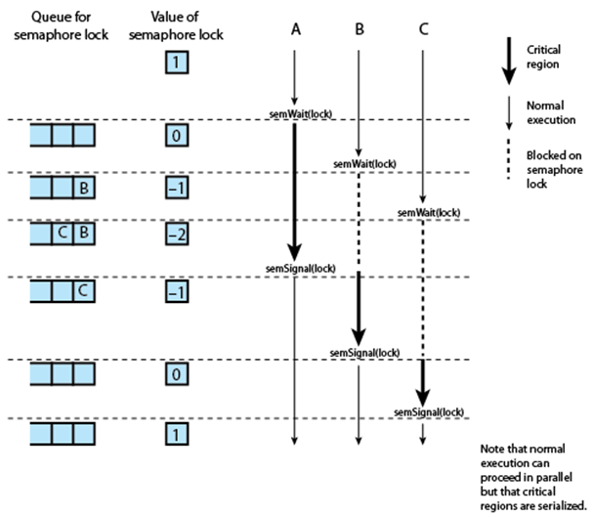

Slide 19
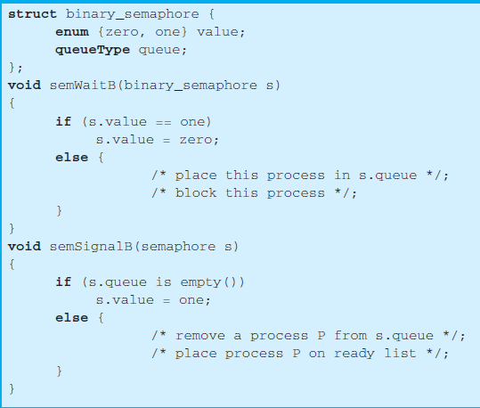
Binary Semaphore

Slide 20
Producer Consumer Problem
One or more producers generates data and place it in buffer
Consumer taking out data from the buffer
Constraints
Only one function (producer or consumer) can access the buffer at any time.
Consumer can consume only if some data has been produced by the producer

Slide 21
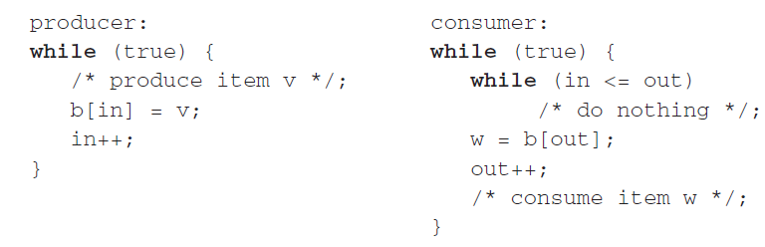
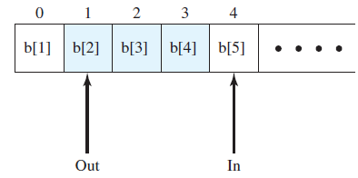
Producer Consumer Problem

Slide 22
Implementation of Producer Consumer Problem using binary Semaphores

Slide 23
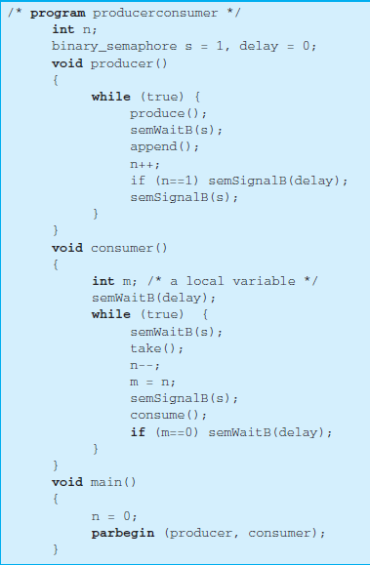

Slide 24
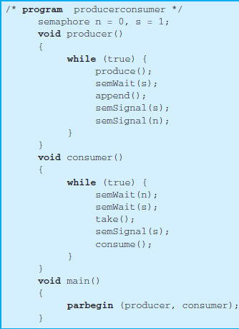

Slide 25
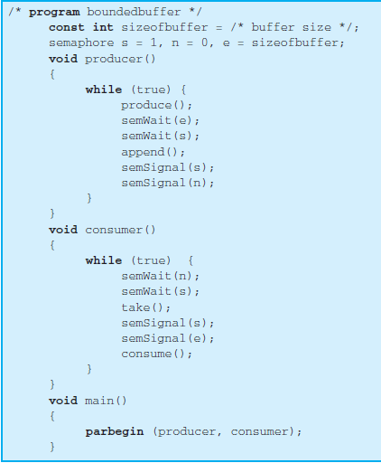

Slide 26
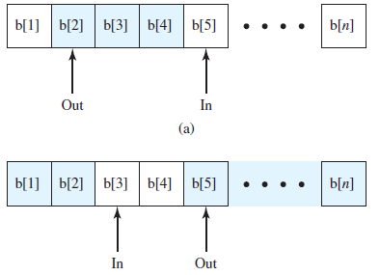
Producer Consumer Problem in circular buffer

Slide 27
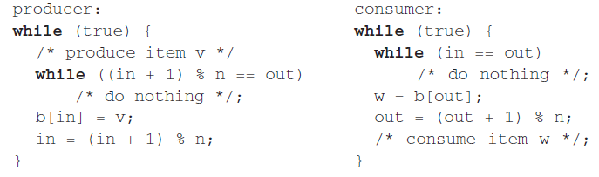
Producer Consumer Problem in circular buffer

Slide 28
Deadlock
Permanent blocking of a set of processes that compete for system resources
Involve conflicting needs for resources by two or more processes

Slide 29
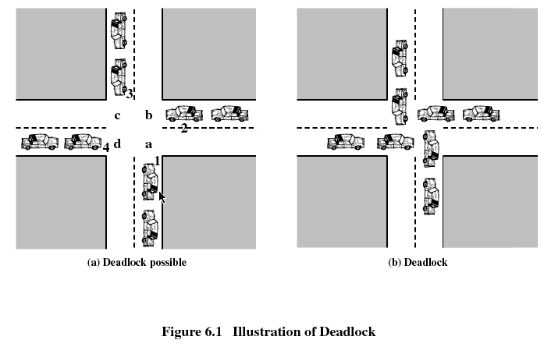
Deadlock

Slide 30
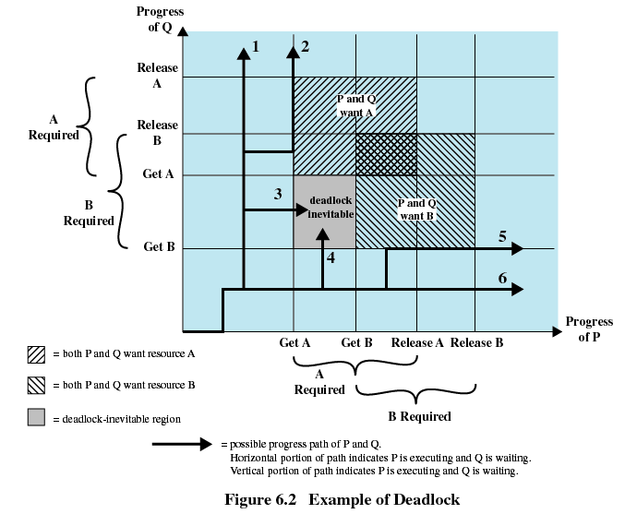

Slide 31
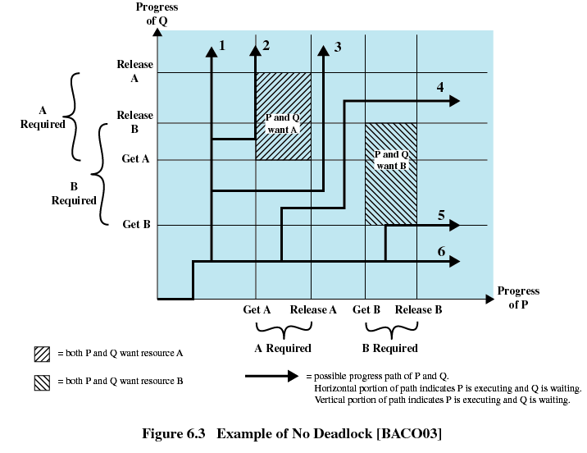

Slide 32
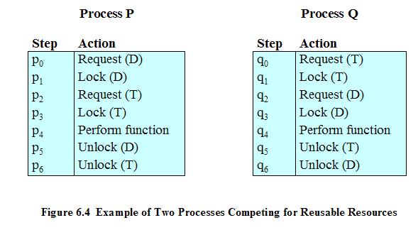
Example of Deadlock

Slide 33
Another Example of Deadlock
Space is available for allocation of 200Kbytes, and the following sequence of events occur
Deadlock occurs if both processes progress to their second request
P1
P2
. . .
. . .
Request 80 Kbytes;
Request 70 Kbytes;
. . .
. . .
Request 60 Kbytes;
Request 80 Kbytes;

Slide 34
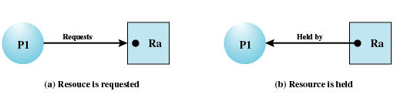
Resource Allocation Graphs
Directed graph that depicts a state of the system of resources and processes

Slide 35
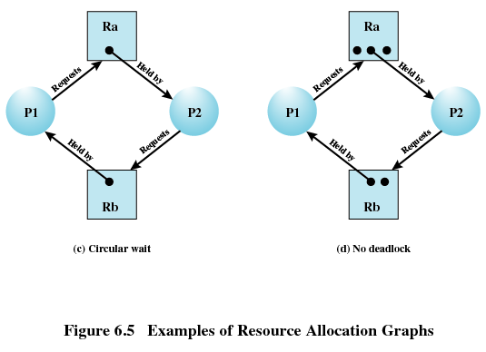
Resource Allocation Graphs

Slide 36
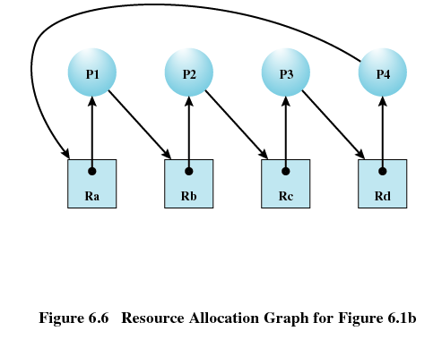

Slide 37
Conditions for Deadlock
Mutual exclusion
Only one process may use a resource at a time
Hold-and-wait
A process may hold allocated resources while awaiting assignment of others
No preemption
No resource can be forcibly removed form a process holding it

Slide 38
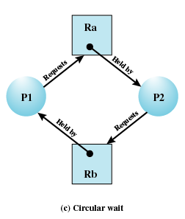
Conditions for Deadlock
Circular wait
A closed chain of processes exists, such that each process holds at least one resource needed by the next process in the chain

Slide 39
Possibility of Deadlock
Mutual Exclusion
No preemption
Hold and wait

Slide 40
Existence of Deadlock
Mutual Exclusion
No preemption
Hold and wait
Circular wait

Slide 41
Deadlock Prevention
Avoiding one of the nec conditions
Mutual Exclusion
Hold and Wait
No Preemption
Avoiding Circular Wait
Problem
Not possible all the time
Will slow down performance
Inefficient use of resources

Slide 42
Deadlock Avoidance
Allow nec conditions but make sure that deadlock point is never reached
Decision is made dynamically
Do not start a process if its demands might lead to deadlock

Slide 43
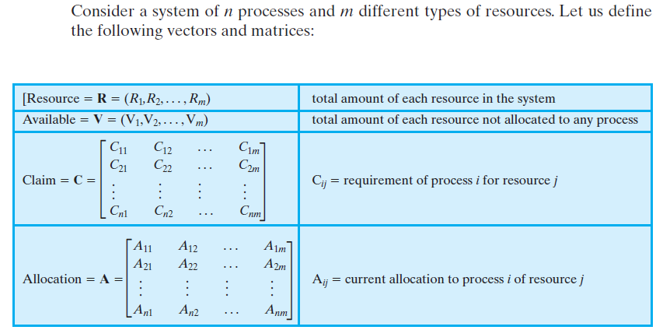
Deadlock Avoidance

Slide 44
Deadlock Avoidance
We can define a deadlock avoidance policy that refuses to start a process if its resource requirements might lead to deadlock
Referred to as banker’s algorithm

Slide 45
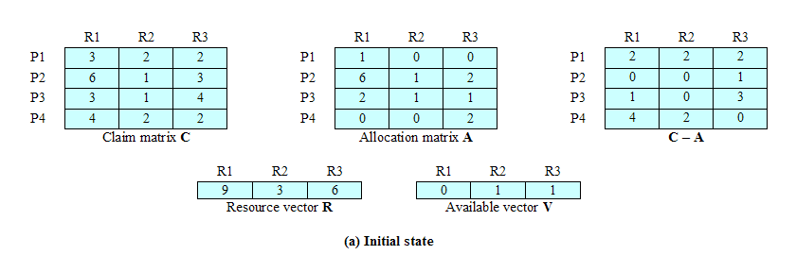
Initial State

Slide 46
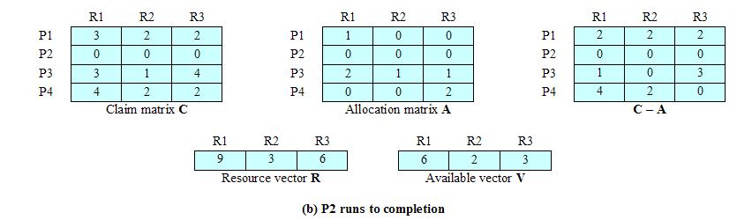
Determination of a Safe State P2 Runs to Completion

Slide 47
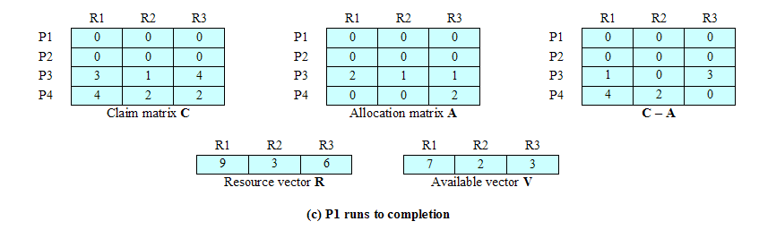
Determination of a Safe State P1 Runs to Completion

Slide 48
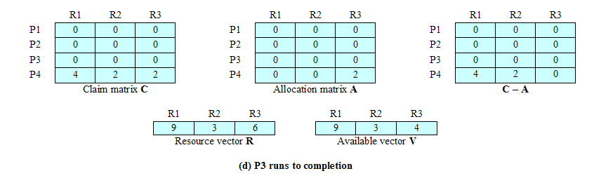
Determination of a Safe State P3 Runs to Completion

Slide 49
Deadlock Avoidance
Safe State: There is at least one sequence of resource allocation that does not result in deadlock
Unsafe State: State that is not safe

Slide 50
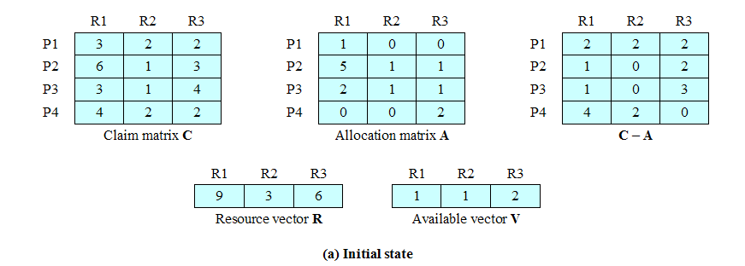
Unsafe State

Slide 51
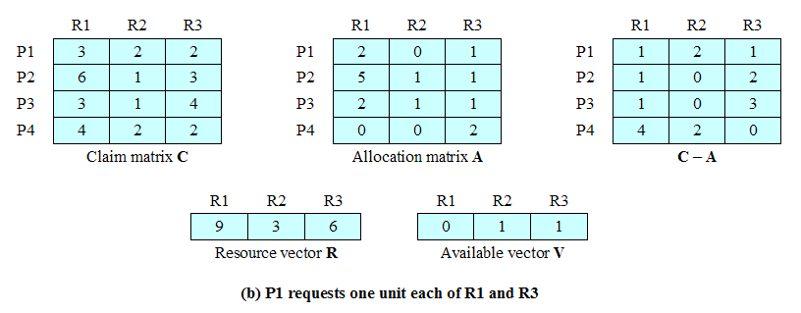
P1 request one additional unit of R1 and R3
Unsafe state but it might not result in deadlock

Slide 52
Deadlock Avoidance
Advantages
No need to preempt or rollback a process
Less restrictive than deadlock prevention
Disadvantages
Maximum resource requirement must be stated in advance (not possible in most circumstances)

Slide 53
Deadlock Detection
Do not limit resource access and do not restrict process actions
Requested resources are granted to processes whenever possible
Periodically, operation system run deadlock detection algorithm to check the circular wait condition

Slide 54
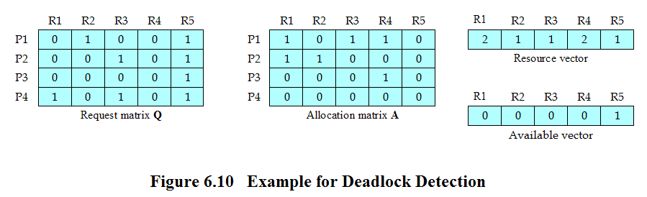
Deadlock Detection

Slide 55
Strategies once Deadlock Detected
Abort all deadlocked processes
Back up each deadlocked process to some previously defined checkpoint, and restart all process
Successively abort deadlocked processes until deadlock no longer exists
Successively preempt resources until deadlock no longer exists

Slide 56
Selection Criteria Deadlocked Processes
Least amount of processor time consumed so far
Least number of lines of output produced so far
Most estimated time remaining
Least total resources allocated so far
Lowest priority

Slide 57
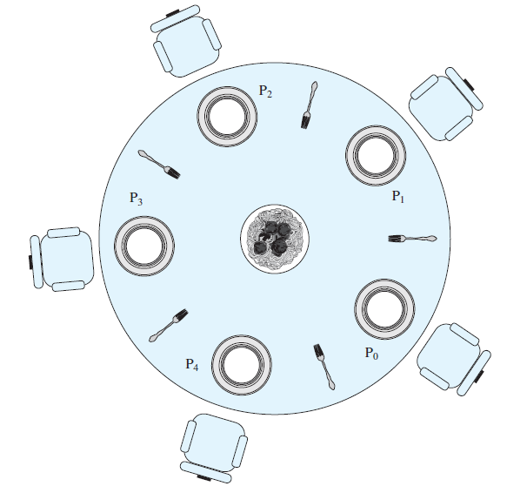
Dining Philosophers Problem

Slide 58
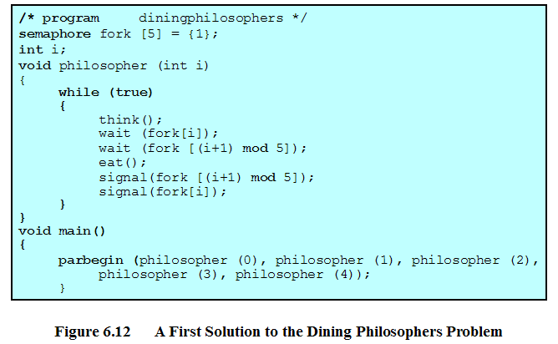
Dining Philosophers Problem

Slide 59
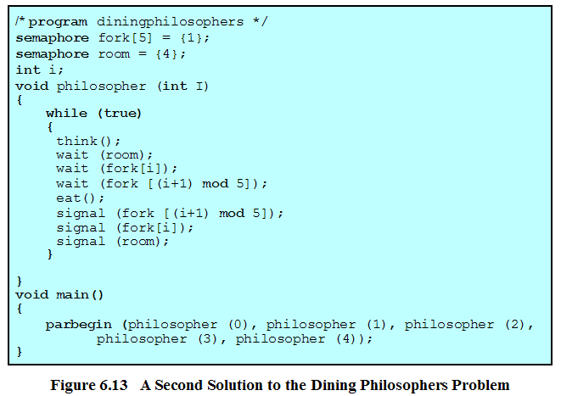
Dining Philosophers Problem

